Slide 1
E-BUSINESS
Chapter 3

Slide 2
Disruptive Technology
How can a company like Polaroid go bankrupt?
Digital Darwinism – implies that organizations which cannot adapt to the new demands placed on them for surviving in the information age are doomed to extinction
Other examples?

Slide 3
Disruptive versus Sustaining Technology
What do steamboats, transistor radios, and Intel’s 8088 processor all have in common?
Disruptive technology – a new way of doing things that initially does not meet the needs of existing customers
Sustaining technology – produces an improved product customers are eager to buy

Slide 4
The Internet as a Business Disruption
Organizations must be able to transform as markets, economic environments, and technologies change
Focusing on the unexpected allows an organization to capitalize on the opportunity for new business growth from a disruptive technology

Slide 5
The Internet as a Business Disruption (contd.)

Slide 6
Evolution of the World Wide Web
Began as an emergency military communications system operated by the Department of Defense
Gradually the Internet moved from a military pipeline to a communication tool for scientists to businesses
World Wide Web (WWW)
A global hypertext system that uses the Internet as its transport mechanism
Hypertext transport protocol (HTTP)
The Internet standard that supports the exchange of information on the WWW

Slide 7
WWW – A New Era
The Internet makes it possible to perform business in ways not previously imaginable
It can also cause a digital divide
Digital divide – when those with access to technology have great advantages over those without access to technology

Slide 8
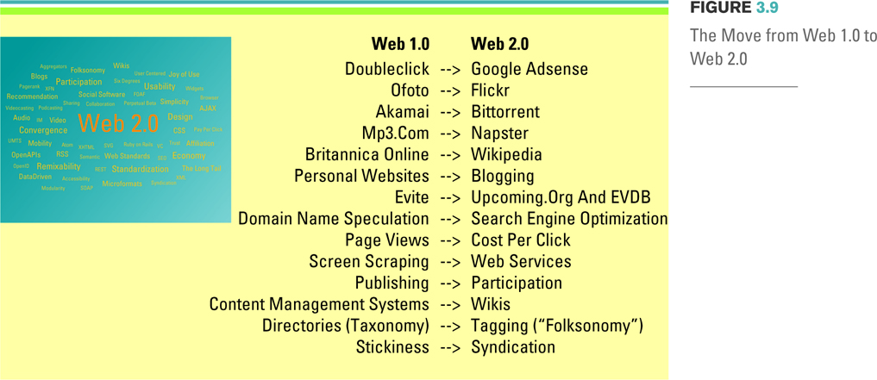
WEB 2.0
Web 2.0 - a set of economic, social, and technology trends that collectively form the basis for the next generation of the Internet

Slide 9
Mashups
Web Mashup
A website or web application that uses content from more than one source to create a completely new service
Application programming interface (API)
A set of routines, protocols, and tools for building software applications
Mashup editor - WSYIWYGs (What You See Is What You Get) for mashups

Slide 10
E-Business Basics
How do ecommerce and e-business differ?
Ecommerce
The buying and selling of goods and services over the Internet
E-Business
The conducting of business on the Internet including, not only buying and selling, but also serving customers and collaborating with business partners

Slide 11
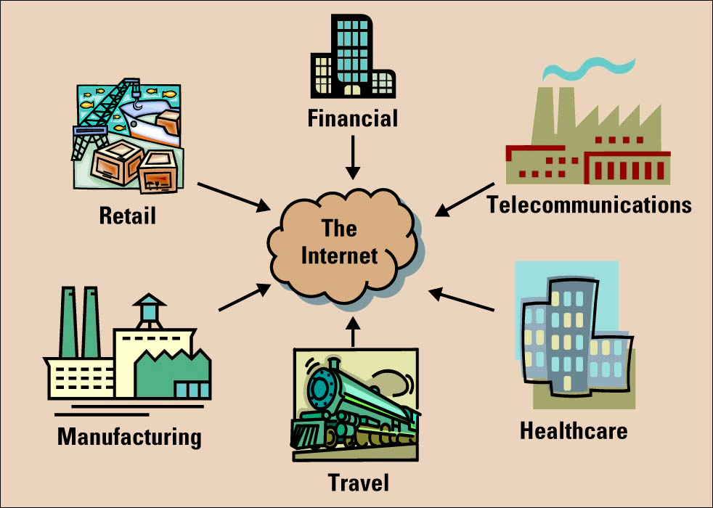
Industries Using E-Business

Slide 12
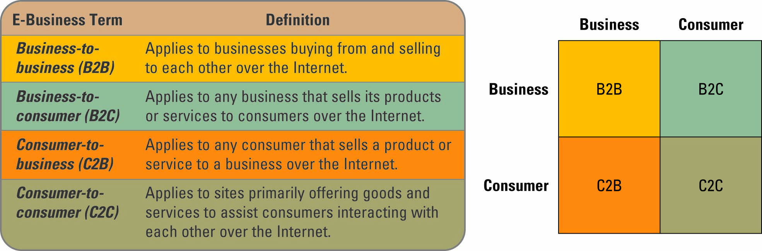
E-Business Models
E-Business model – an approach to conducting electronic business on the Internet

Slide 13
E-Business Models (Contd.)

Slide 14
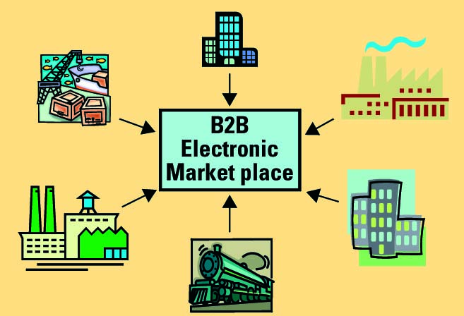
Business-to-Business (B2B)
Electronic marketplace (emarketplace) – interactive business communities providing a central market where multiple buyers and sellers can engage in e-business activities

Slide 15
Business-to-Consumer (B2C)
Common B2C e-business models include:
E-shop – a version of a retail
E-mall – consists of a number of e-shops
Business types include:
Brick-and-mortar business
Pure-play business
Click-and-mortar business

Slide 16
Consumer-to-Business (C2B)
Priceline.com is an example of a C2B e-business model
The demand for C2B e-business will increase over the next few years due to customer’s desire for greater convenience and lower prices

Slide 17
Consumer-to-Consumer (C2C)
Online auctions
Electronic auction (e-auction) - sellers and buyers solicit bids and prices are determined dynamically
Forward auction - a selling channel to many buyers and the highest bid wins
Reverse auction - buyers use to purchase a product or service, selecting the seller with the lowest bid

Slide 18
Consumer-to-Consumer (C2C) (Contd.)
C2C Communities
Communities of interest - People interact with each other on specific topics, such as golfing and stamp collecting
Communities of relations - People come together to share certain life experiences, such as cancer patients, senior citizens, and car enthusiasts
Communities of fantasy - People participate in imaginary environments, such as fantasy football teams and playing one-on-one with Michael Jordan

Slide 19
Organizational Strategies For E-Business
Primary business areas taking advantage of e-business include:
Marketing/sales
Financial services
Procurement
Customer service
Intermediaries

Slide 20
Marketing/Sales
Generating revenue on the Internet. Few examples:
Online ad (banner ad) - box running across a web page that contains advertisements
Associate program (affiliate program) - businesses generate commissions or royalties
Personalization - occurs when a website can fashion offers that are more likely to appeal to that person
Search engine optimization (SEO) - a set of methods aimed at improving the ranking of a website in search engine listings

Slide 21
Financial Services
Online consumer payments include:
Financial cybermediary
Electronic check
Electronic bill presentment and payment (EBPP)
Digital wallet

Slide 22
Procurement
Maintenance, repair, and operations (MRO) materials (also called indirect materials)
materials necessary for running an organization but do not relate to the company’s primary business activities
E-procurement - the B2B purchase and sale of supplies and services over the Internet
Electronic catalog - presents customers with information about goods and services offered for sale, bid, or auction on the Internet

Slide 23
Customer Service
The business process where the most human contact occurs between a buyer and a seller
E-business strategists are finding that customer service via the Web is one of the most challenging and potentially lucrative areas of e-business
The primary issue facing customer service departments using e-business is consumer protection

Slide 24
Intermediaries
Intermediaries – agents, software, or businesses that bring buyers and sellers together that provide a trading infrastructure to enhance e-business
Reintermediation – using the Internet to reassemble buyers, sellers, and other partners in a traditional supply chain in new ways

Slide 25
Measuring E-Business Success
Most companies measure the traffic on a website as the primary determinant of the website’s success
However, a large amount of website traffic does not necessarily equate to large sales
Many organizations with high website traffic have low sales volumes

Slide 26
Measuring E-Business Success (Contd.)
Clickstream data tracks the exact pattern of a consumer’s navigation through a website
Clickstream data can reveal:
Number of pageviews
Pattern of websites visited
Length of stay on a website
Date and time visited
Number of customers with shopping carts
Number of abandoned shopping carts

Slide 27
E-Business Benefits
Highly accessible
Increased customer loyalty
Improved information content
Increased convenience
Increased global reach
Decreased cost

Slide 28
E-Business Challenges
Protecting consumers
Leveraging existing systems
Increasing liability
Providing security
Adhering to taxation rules

